Slide 1
Day 21
Kalman Filter Examples

Slide 2
Static State Estimation
recall the static state estimation problem we have been studying
  the process or plant model
  the observation model

Slide 3
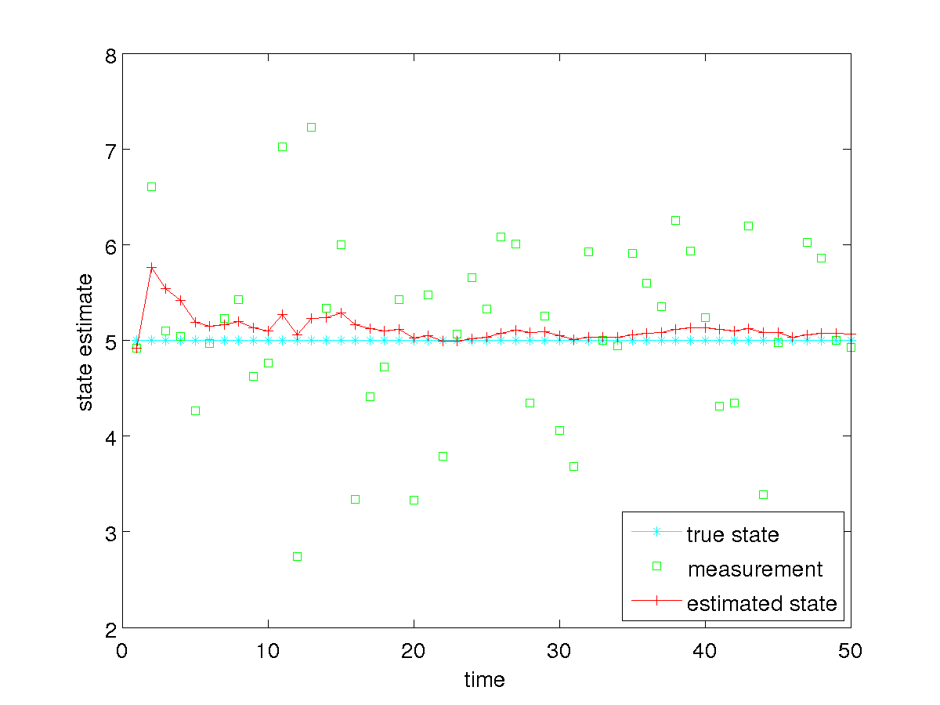
Static State Estimation
how well does the Kalman filter work

Slide 4
Static State Estimation
notice that we need to specify the measurement noise covariance Q_{t}
how sensitive is the Kalman filter to Q_{t} ?
  e.g., what if we use a Q_{t} that is much smaller than the actual measurement noise?
  e.g., what if we use a Q_{t} that is much larger than the actual measurement noise?

Slide 5
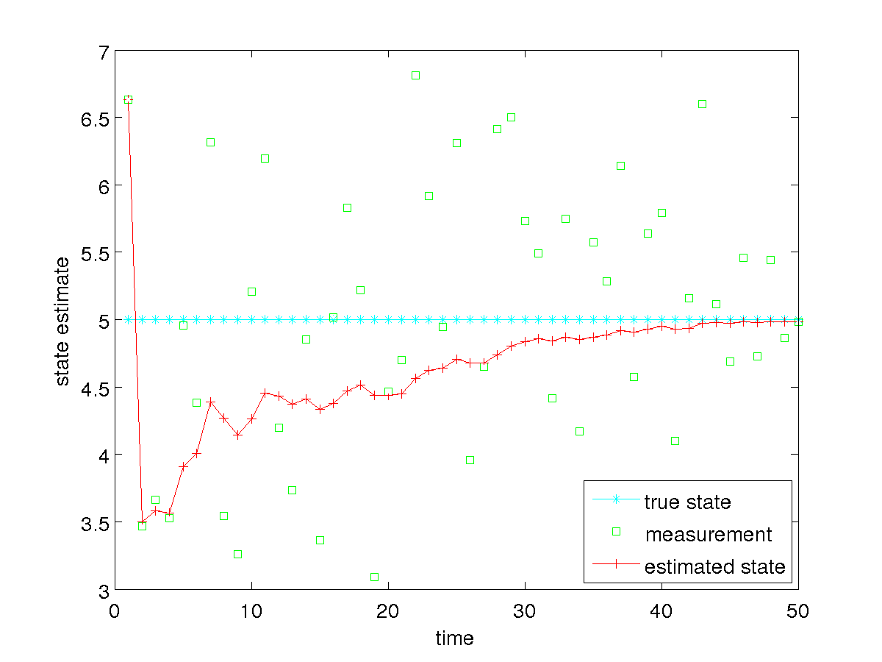
Static State Estimation
specified Q_{t} = 0.01 * actual Q_{t}

Slide 6
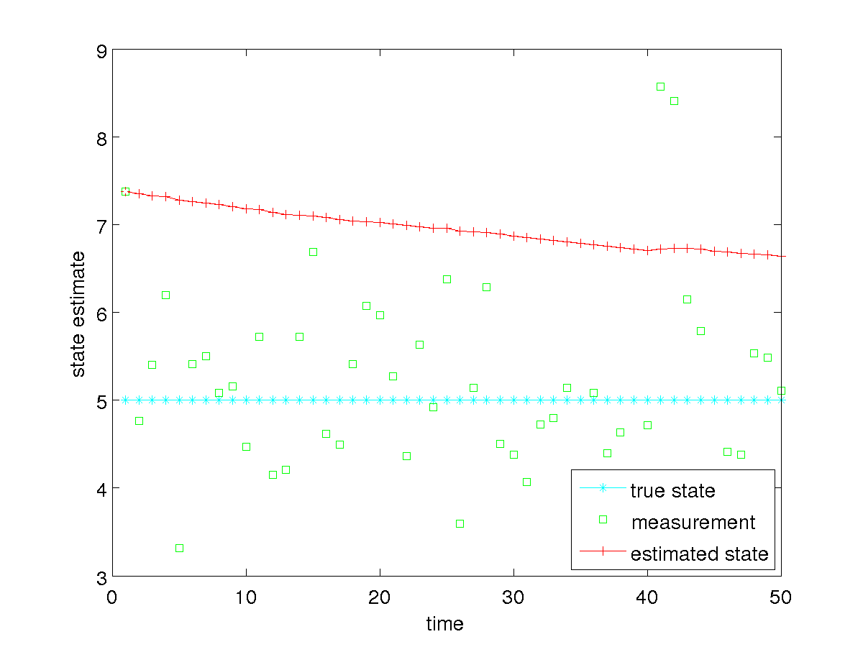
Static State Estimation
specified Q_{t} = 100 * actual Q_{t}

Slide 7
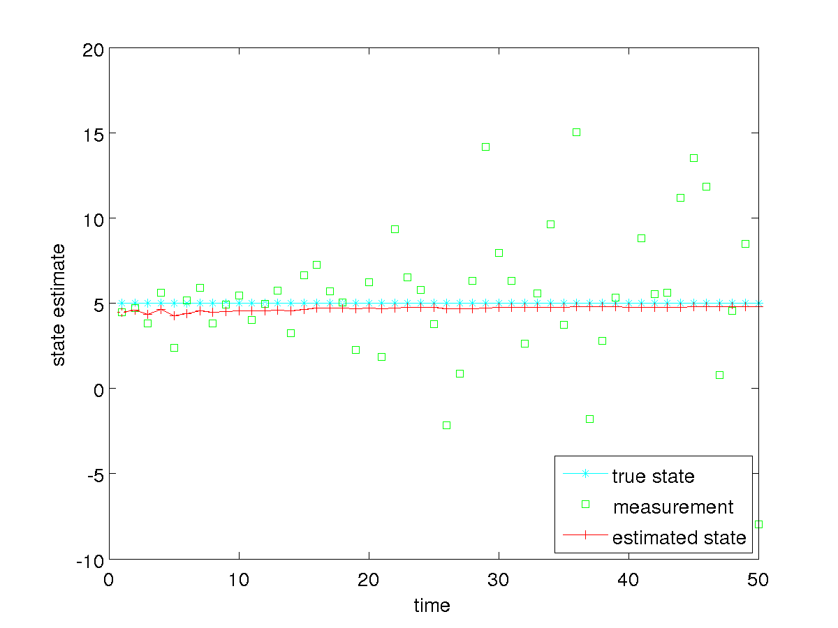
Static State Estimation
suppose our measurements get progressively noisier over time
noise variance increases 10% for each successive measurement

Slide 8
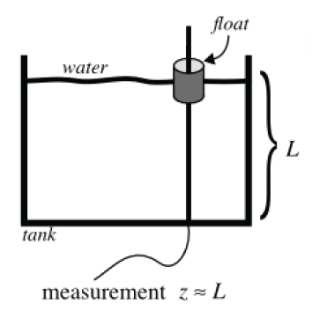
Tank of Water
estimate the level of water in the tank; the water could be
  static, filling, or emptying
  not sloshing or sloshing

Slide 9
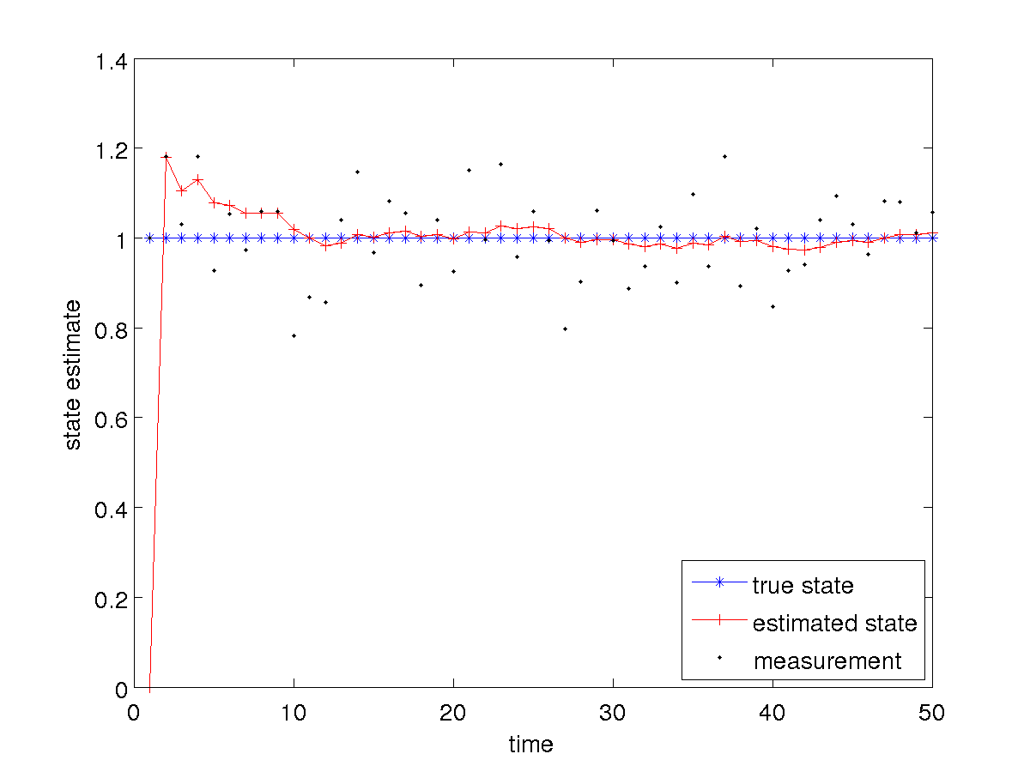
Tank of Water: Static and Not Sloshing

Slide 10
Tank of Water: Static and Not Sloshing
notice that in this case the Kalman filter tends towards estimating a constant level because the plant noise covariance is small compared to the measurement noise covariance
  the estimated state is much smoother than the measurements
what happens if we increase the plant noise covariance?

Slide 11
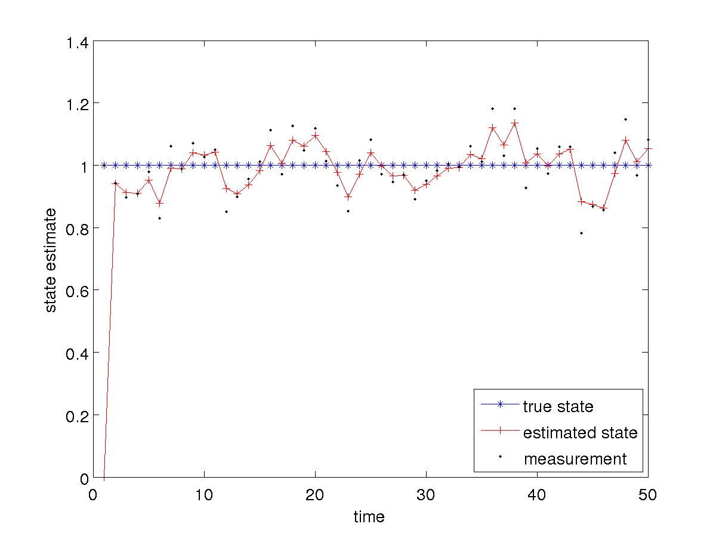
Tank of Water: Filling and Not Sloshing

Slide 12
Tank of Water: Static and Not Sloshing
notice that in this case the Kalman filter tends towards estimating values that are closer to the measurements
increasing the plant noise covariance causes the filter to place more weight on the measurements

Slide 13
Tank of Water: Filling and not Sloshing
suppose the true situation is that the tank is filling at a constant rate but we use the static tank plant model
  i.e., we have a plant model that does not accurately model the state transition

Slide 14
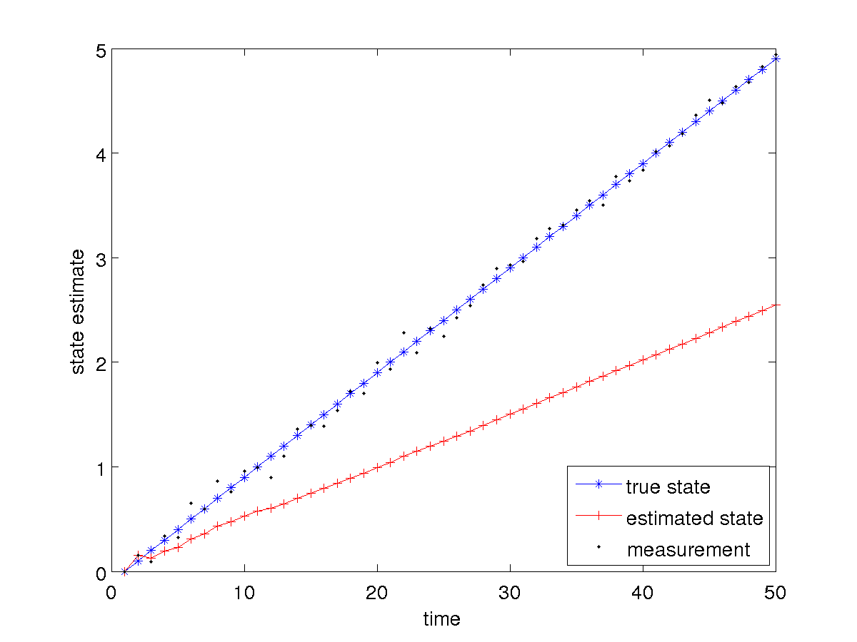
Tank of Water: Filling and not Sloshing

Slide 15
Tank of Water: Filling and not Sloshing
notice that in this case the estimated state trails behind the true level
  estimated state has a much greater error than the noisy measurements
if the plant model does not accurately model reality than you can expect poor results
  however, increasing the plant noise covariance will allow the filter to weight the measurements more heavily in the estimation…

Slide 16
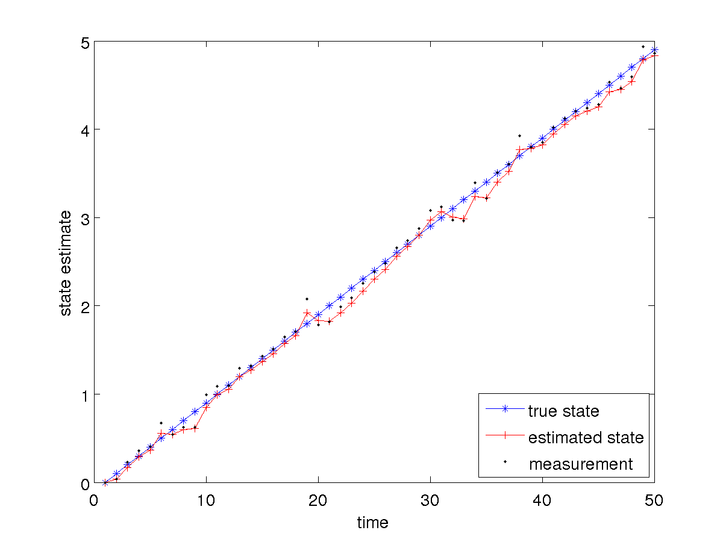
Tank of Water: Filling and not Sloshing

Slide 17
Tank of Water: Filling and not Sloshing
it is not clear if we have gained anything in this case
  the estimated state is reasonable but it is not clear if it is more accurate than the measurements
what happens if we change the plant model to more accurately reflect the filling?

Slide 18
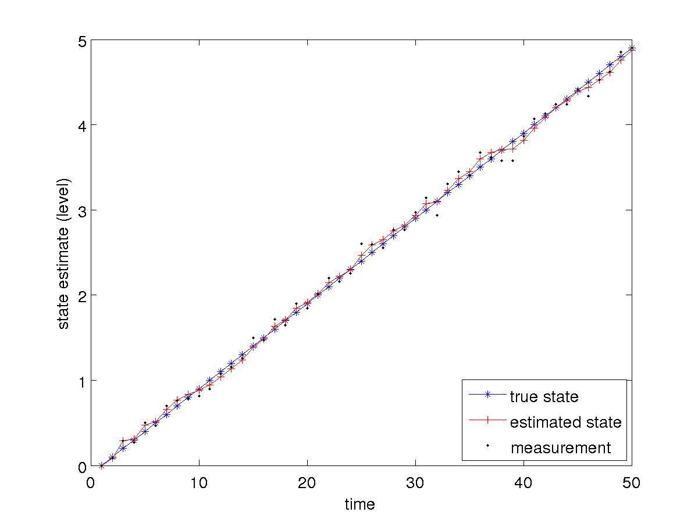
Tank of Water: Filling and not Sloshing

Slide 19
Tank of Water: Filling and not Sloshing
notice that the estimated state is more accurate and smoother than the measurements
what about the filling rate?

Slide 20
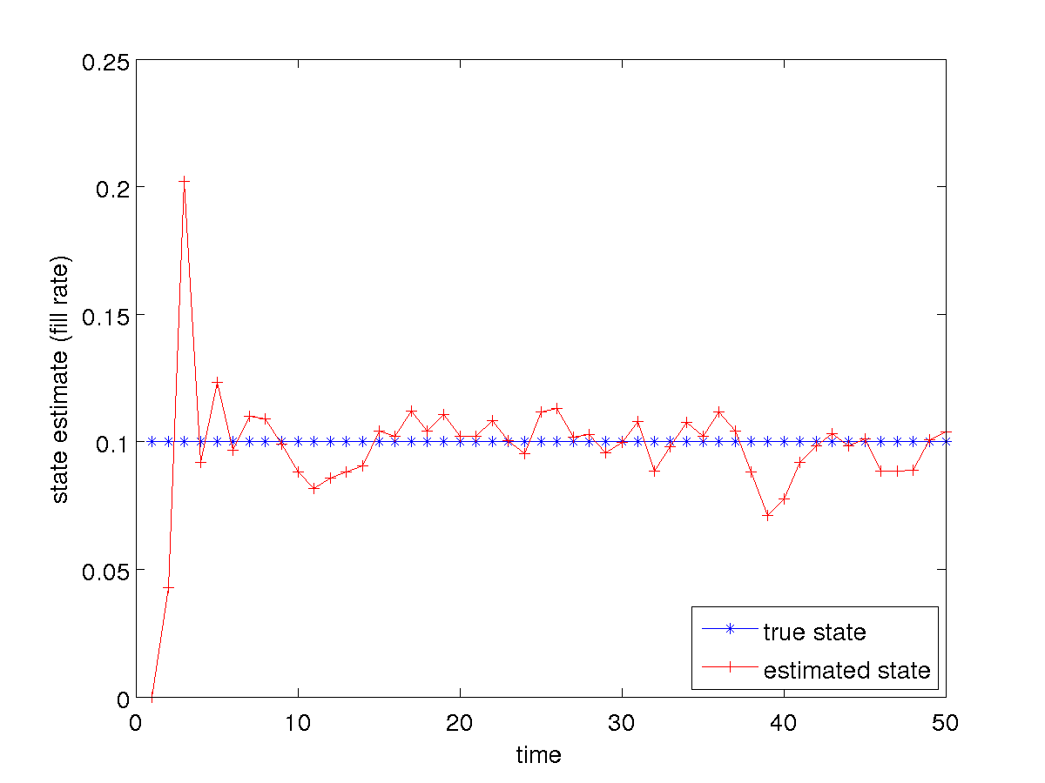
Tank of Water: Filling and not Sloshing

Slide 21
Tank of Water: Filling and not Sloshing
notice that the estimated filling rate seems to jump more than the estimated level
  this should not be surprising as we never actually measure the filling rate directly
    it is being inferred from the measured level (which is quite noisy)

Slide 22
Tank of Water: Static and not Sloshing
can we trick the filter by using the filling plant model when the level is static?
  hopefully not, as the filter should converge to a fill rate of zero!

Slide 23
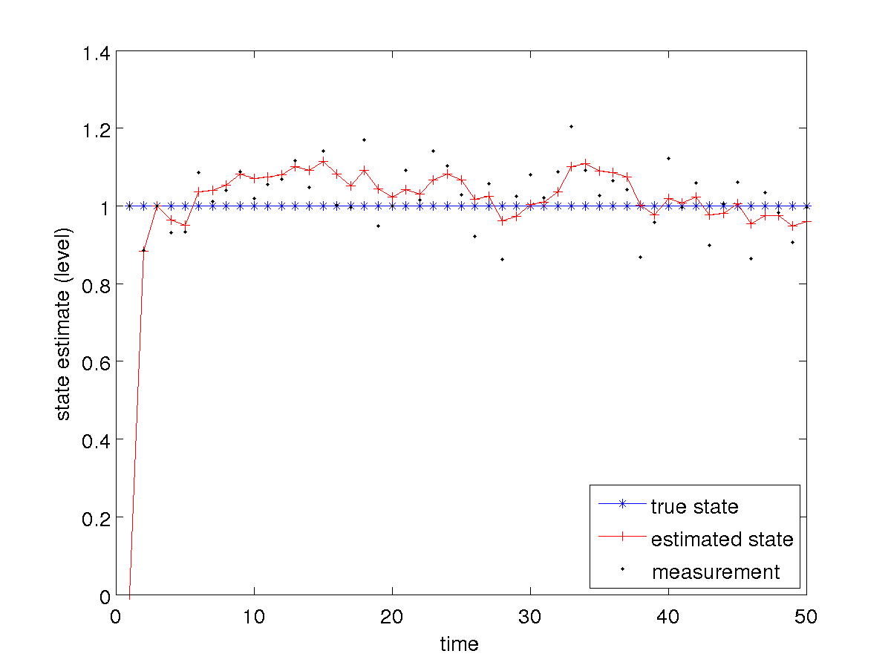
Tank of Water: Static and not Sloshing

Slide 24
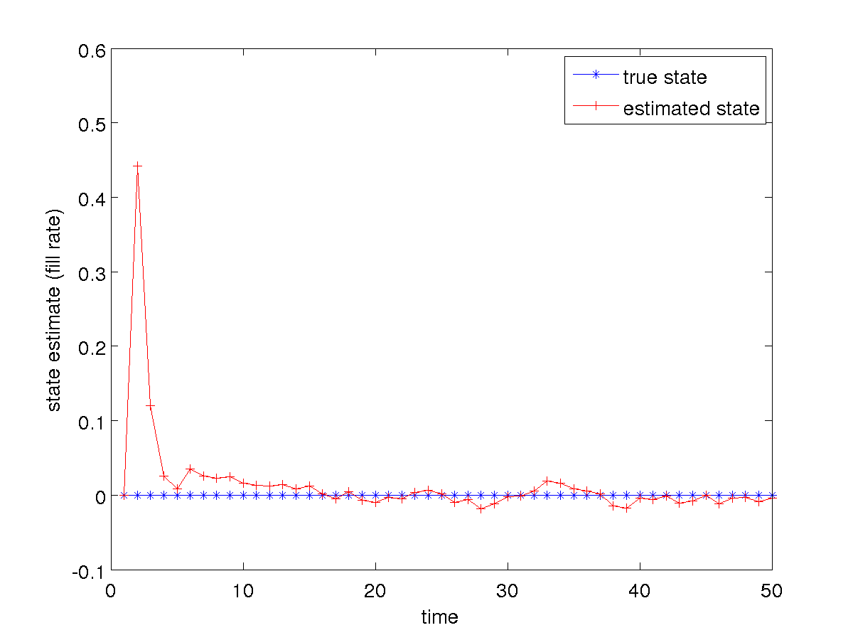
Tank of Water: Static and not Sloshing

